Slide 1

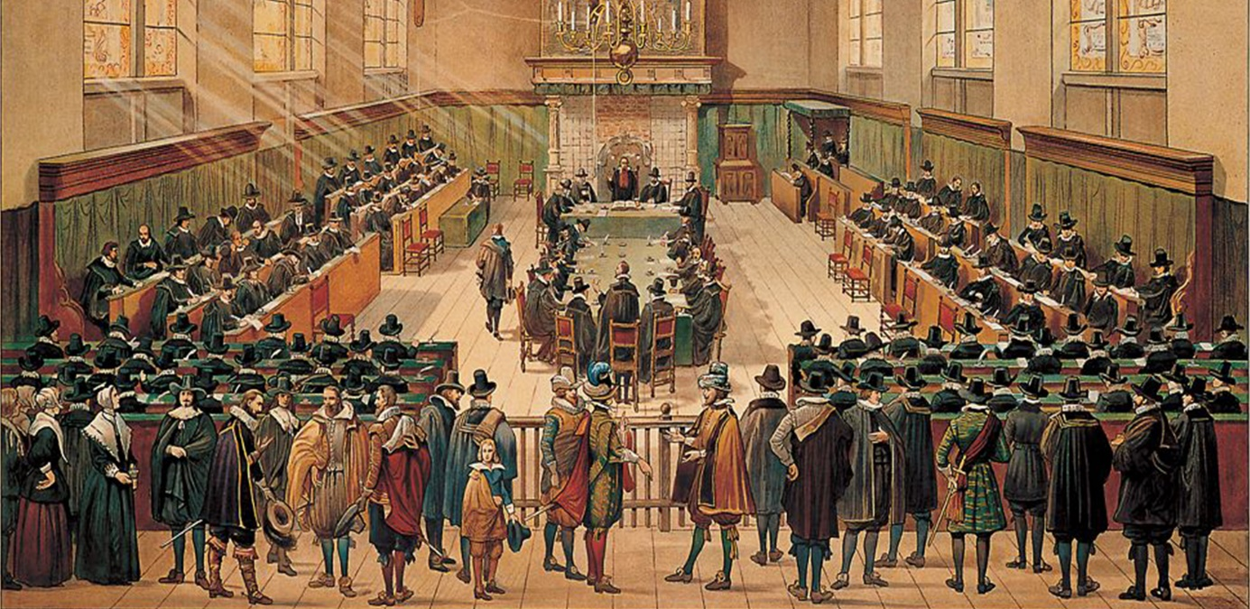
        Church Scapes
        Lecture 1
        Contintental Reformed
        Wednesday, October 1, 2025

Slide 2

Psalm 124:3
God rescued us from teeth that rip and tear.
Praise him who broke the fowler’s deadly snare.
We have escaped, are free now like a bird.
Our help comes from the LORD who hears our prayer,
from him who shaped creation by his word.
Titus 1:5 – 2:1
Notes:
Song associated with the Liberation of 1944

Slide 3
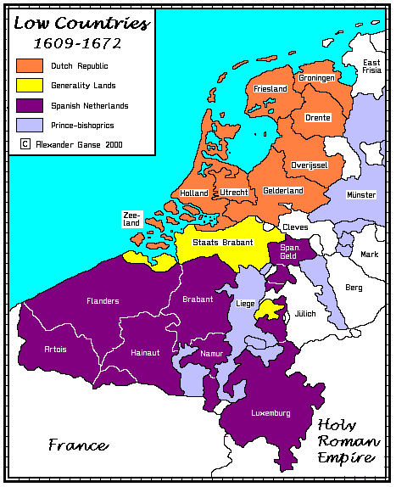
The Low Countries
“Low Countries” = Netherlands, Belgium, & Luxemburg
(aka Benelux)
- Where Rhine, Maas & Schelde flow into the North Sea
- Languages: French, Dutch, German, Frisian

Slide 4
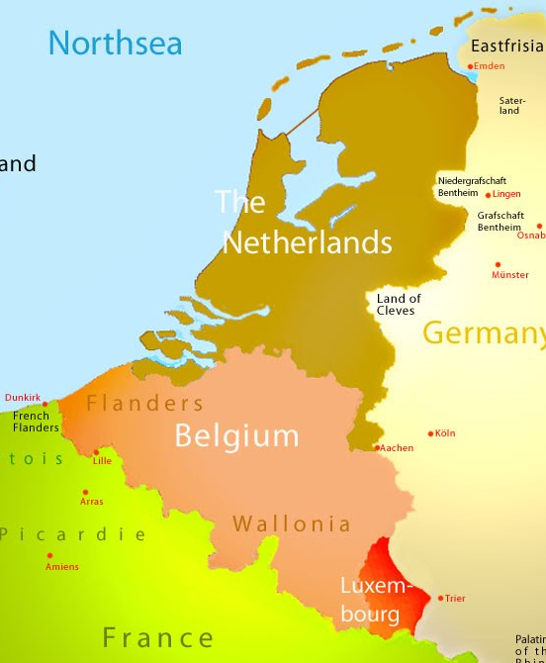
The Low Countries

Slide 5
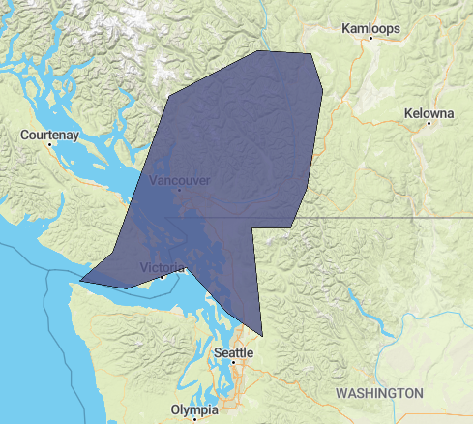
Notes:
Canada is 240x the size of the Netherlands. But remember, travel back in the 1500s was slow.

Slide 6
The Low Countries
Late 1500s
  War! 80 year war (Low Countries vs. Spain)
  Reformation advances from France northwards
  Dutch Refugees
    “Low church” in London (England) and Emden (Germany)
    “High church” in Heidelberg and Frankfurt (Germany)
  1571: formation of the Dutch Reformed church
    Dutch and French influences
  Freedom is slowly won in the northern half of The Netherlands.
  Church life settles with the Reformed dominating as the ruling House of Orange is Reformed
  The northern Low Countries become a haven for refugees as tolerance of all religions is practised

Slide 7
The Low Countries
Orange = Reformed
Yellow = mixed
Purple & blue = Roman Catholic
Note: Julich, Berg, Mark, and East Frisia are German and Lutheran

Slide 8
Trouble!
Disputes at the University of Leiden
  Prof. Arminius (died 1609)
  Prof. Gomarus
Remonstrance of 1610
  5 articles that contradicted Reformed convictions found in the Belgic Confession articles 14-16
Counter Remonstrance of 1611
Disputes
  Leaders and Churches choose sides
  Government calls a synod to settle the matter in 1618
    Concern about a civil war beginning over the issue

Slide 9
The Great Synod of Dort
A synod of all Dutch Reformed churches.
  Each Reformed province sent delegates
  The government also had a role
Invitation sent to all Reformed churches elsewhere in Europe.
  British (including an Anglican bishop)
  German, Swiss
  French Huguenots (own government stopped them)
Remonstrants were in the minority
  Refused to cooperate for 5 straight weeks.
  Ended up being thrown out of the synod

Slide 10

The synod of Dort

Slide 11
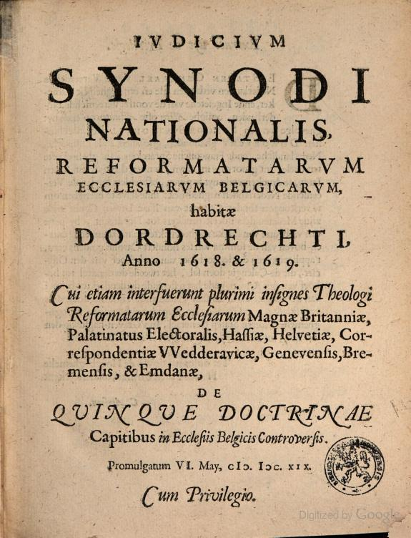
The Great Synod of Dort
Some five months spent on doctrine
  End result: Canons of Dort
  defends God’s sovereignty in salvation (election-justification-sanctification-glorification)

Slide 12
The Great Synod of Dort
Another solid month on church governance
  End result: Church Order of Dort
  Defends independence of local churches ruled by elders (presbyters)
  Posits that elders can only rule through councils
    Elders come together (synodos) in a eldership (presbyterion)
  Defends unity of churches who cvonnect through assemblies
  Thus Dort polity is known as “presbyterial-synodal” polity
  Failed to keep the State out of church business
The government put a lid on all church issues, disallowed national synods, and there was little church trouble for the next 200 years(!) in the Low Countries.
Notes:
Presbyterial: pertaining to elders
Synodal: pertaining to assemblies

Slide 13
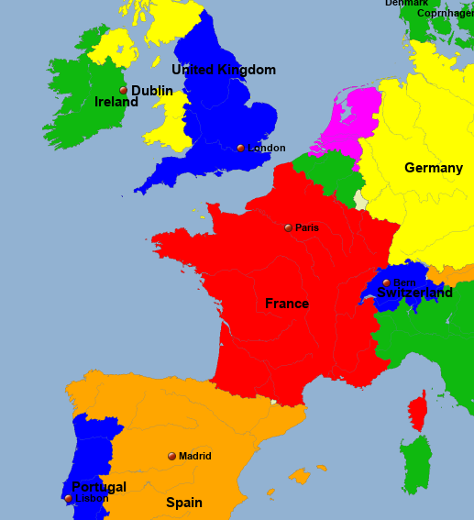
France – Huguenots

Slide 14
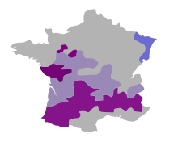
France – Huguenots
Scotland
England
Low Countries
Germany
Purple – Huguenot
Lilac – contested
Blue – German Reformed
Grey – Catholic
Spain
Italy

Slide 15
France – Huguenots
Scotland
England
Low Countries
Germany
Purple – Huguenot
Lilac – contested
Blue – German Reformed
Grey – Catholic
Spain
Italy

Slide 16

France – Huguenots
1559: Reformed Churches of France
Battle between 3 rival royal houses
  Valois (flipflop) Bourbon (Protestant), Guise (Roman Catholic)
1572: St. Bartholomew Day’s Massacre
  Wedding of Henry III of Navarre (Bourbon)
  to Margaret (Valois)
  Queen Catharine de Medici (regent at the time)
  assassinates a Huguenot admiral
  Sparks a huge massacre by Romanists of
  Huguenots, beginning in Paris and spreading
  throughout France
Notes:
Valwah. Boerbon. Gaiz.
Massacre: Queen Catherine de’ Medici is against the Huguenots and wanted a powerful Huguenot admiral killed. The first attempt failed.
A powerful Huguenot admiral was assassinated during the marriage of Henry III of Navarre (house of Bourbon) to the king’s sister Margaret (house of Valois).
The assassination sparked a massacre, which spread from Paris to other French provinces.
1685: The Netherlands received the most Huguenot refugees: 75,000-100,000 including 200 pastors.
Huguenots had been banned from Canada in 1633, and again in 1685.

Slide 17
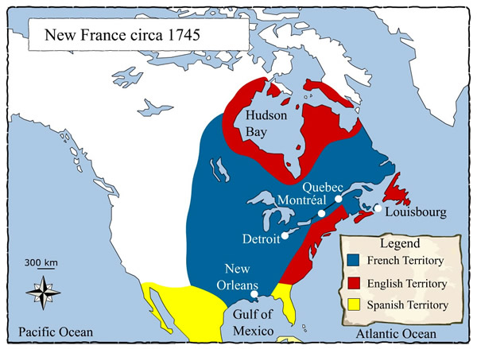
France – Huguenots
1598: Edict of Nantes (Tolerance!)
  Henry III of Navarre (Bourbon) becomes King Henry IV
    He becomes a Catholic: “Paris is worth a mass”
  Catholic France now tolerates Huguenots
  Huguenots gain centres of power and learning
1633: New France
bans Huguenots
Notes:
Valwah. Boerbon. Gaiz.
Massacre: Queen Catherine de’ Medici is against the Huguenots and wanted a powerful Huguenot admiral killed. The first attempt failed.
A powerful Huguenot admiral was assassinated during the marriage of Henry III of Navarre (house of Bourbon) to the king’s sister Margaret (house of Valois).
The assassination sparked a massacre, which spread from Paris to other French provinces.
1685: The Netherlands received the most Huguenot refugees: 75,000-100,000 including 200 pastors.
Huguenots had been banned from Canada in 1633, and again in 1685.

Slide 18
France – Huguenots
1598: Edict of Nantes (Tolerance!)
  Henry III of Navarre (Bourbon) becomes King Henry IV
    He becomes a Catholic: “Paris is worth a mass”
  Catholic France now tolerates Huguenots
  Huguenots gain centres of power and learning
1633: New France (in North America) bans Huguenots
1685: Edict of Fontainebleau revokes Edict of Nantes
  (Old) France bans the Reformed faith
  New France reaffirms ban on Huguenots
  Most Huguenots flee France, many to The Netherlands or South Africa where they are absorbed by the Dutch Reformed churches
Notes:
Valwah. Boerbon. Gaiz.
Massacre: Queen Catherine de’ Medici is against the Huguenots and wanted a powerful Huguenot admiral killed. The first attempt failed.
A powerful Huguenot admiral was assassinated during the marriage of Henry III of Navarre (house of Bourbon) to the king’s sister Margaret (house of Valois).
The assassination sparked a massacre, which spread from Paris to other French provinces.
1685: The Netherlands received the most Huguenot refugees: 75,000-100,000 including 200 pastors.
Huguenots had been banned from Canada in 1633, and again in 1685.

Slide 19
The Netherlands
After Dort 1619 just one Reformed Church
  Basically 200 years of relative peace
    Period of Second Reformation (Puritan emphases)
    1600s: Debates between Coccejans and Voetians, Huguenots arrive
    1700s: Conventicle movement (Jean de Labadie)
1773: A revised psalter (3rd Dutch Genevan Psalter)
  Psalms are embellished, deistic language was used
1806: A vastly expanded hymnal
  Sentimental, subjective, false doctrine
1816: A new church order (General Regulations)
  Church assemblies become government appointed boards
  Doctrinal tolerance was introduced (1827)

Slide 20
Splits & Mergers
GG
HHK
CGKN
1952
DGK
GKN
1967
GKv
2001
2009
NGK
1892
1920s
GKN
1944
1836
NHK
1886
PKN
1946
2004
Notes:
Overview in 2020

Slide 21
Splits & Mergers
GG
HHK
CGKN
1952
DGK
GKN
1967
GKv
2001
2009
1892
NGK
1920s
GKN
1944
1836
NHK
1886
PKN
1946
2004
Notes:
Blue = experiential, Green = covenantal, Red = liberal

Slide 22
Secession
Ledeboerianen
GG
HHK
Churches under the Cross
CGKN
Christian Seceded Church
Drenth Persuasion
1952
Christian Seceded
Church
DGK
1850
Christian Seceded Church
Gelders Persuasion
GKN
1846-1847
VanRaalte – Michigan
Dutch Reformed Church
GKv
1967
2001
2009
Scholte – Iowa
Independent Reformed Church
NGK
1892
1920s
GKN
1944
1836
NHK
1886
PKN
1946
2004

Slide 23
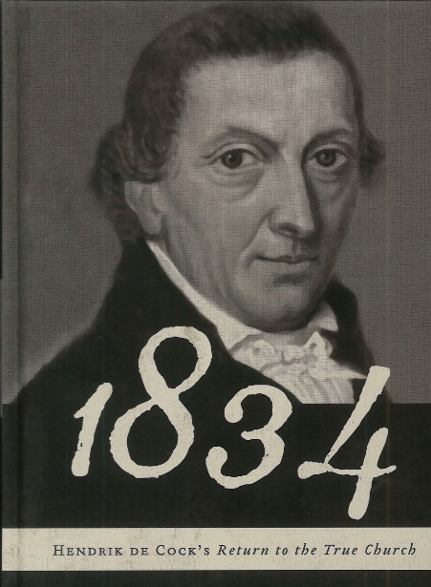
The Netherlands – early 1800s
1834: The Secession
  Doctrinal issues
  Over 120 churches, just 6 ministers
Division within the ranks on
  the church order (H.P. Scholten)
  the covenant (H. de Cock)
  Offer of the Gospel (Drenth and Gelderse Persuasions)
  relation to the government (Cross-churches)
By 1850 three larger groups
  Christian Seceded Reformed Church
  Reformed Churches under the Cross
  Clusters of independent Reformed Congregations
Notes:
Offer of the Gospel: is grace to be preached only to the “obviously elect” or offered to all

Slide 24
Secession
Ledeboerianen
GG
HHK
Churches under the Cross
CGKN
Christian Seceded Church
Drenth Persuasion
1952
Christian Seceded
Church
DGK
1850
Christian Seceded Church
Gelders Persuasion
GKN
1967
GKv
2001
2009
NGK
1892
1920s
GKN
1944
1836
NHK
1886
PKN
1946
2004

Slide 25
Secession
1920s
Old Ref’d Congr’ns
Ledeboerianen
GG
Reformed Congr’ns
HHK
Churches under the Cross
1907
CGKN
1952
1869
Christian Seceded Church
DGK
GKN
1892
GKv
1967
2001
2009
NGK
1892
1920s
GKN
1944
1836
NHK
1886
PKN
1946
2004

Slide 26
The Netherlands – later 1800s
1869: union of Seceder groups
  Cross-churches and Seceders unite
  Formation: Christian Reformed Church (CGK)
    Seminary: Theological School in Kampen
  Reformed Congregations remain separate
1907: Union of most Reformed Congregations (GG)
  Involves remaining Cross Churches
  Some groups remain separate, forming the federation of Old Reformed Congregations (OGG)
1920s: Some GG leave for OGG
  Issue general surrounded offer of the gospel, ethics, and persons

