Slide 1

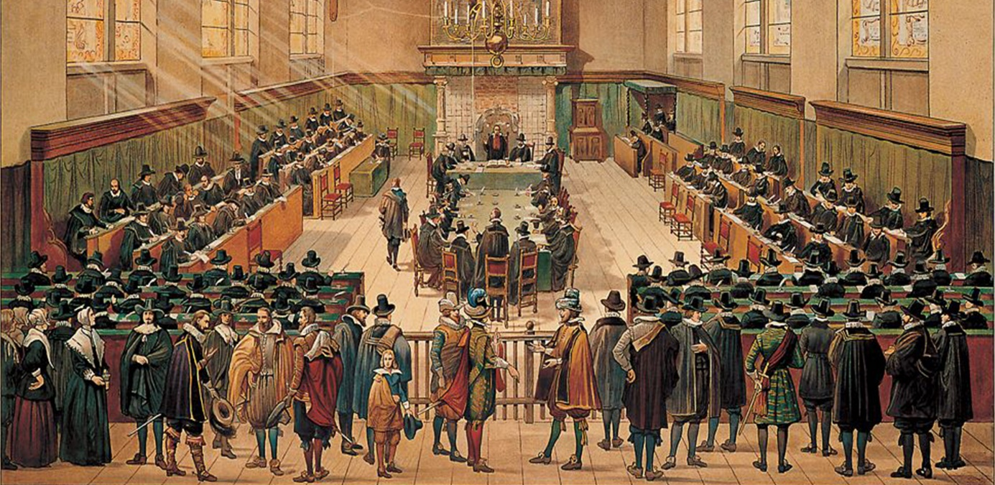
Church Scapes
Lecture 2
Contintental and North American Reformed
Wednesday, October 15, 2025

Slide 2

Organizational
Power point slide show published on the website
Video will be posted in due time as well
Tonight’s lecture:
Dort Reformed in The Netherlands:
Secession to today
Dort Reformed in North America
We’ll see how far we get ☺

Slide 3
Psalm 25:2
Show your paths to me, your servant,
and direct me in your ways.
Lead me in your truth and teach me;
guide and keep me all my days.
LORD, I know your word is true,
and with eager expectation
all day long I hope in you
as the God of my salvation.
Read: 1John 4:1-6
Galatians 1:6-10

Slide 4
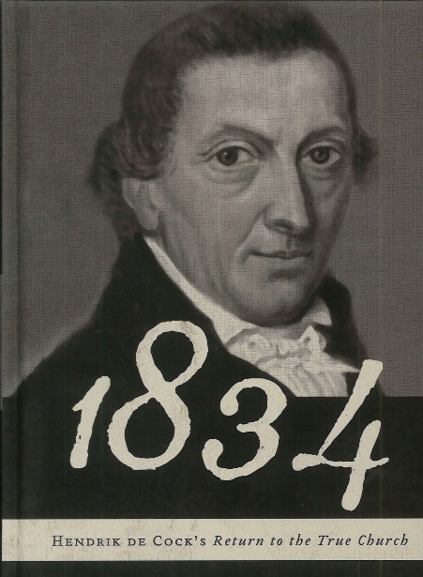
The Netherlands – early 1800s
1834: The Secession
Doctrinal issues
Over 120 churches, just 6 ministers
Division within the ranks on
the church order (H.P. Scholten)
the covenant (H. de Cock)
Offer of the Gospel (Drenth and Gelderse Persuasions)
relation to the government (Cross-churches)
By 1850 three larger groups
Christian Seceded Reformed Church
Reformed Churches under the Cross
Clusters of independent Reformed Congregations
Notes:
Offer of the Gospel: is grace to be preached only to the “obviously elect” or offered to all

Slide 5
The Netherlands – later 1800s
1869: union of Seceder groups
Cross-churches and Seceders unite
Formation: Christian Reformed Church (CGK)
Seminary: Theological School in Kampen
Reformed Congregations remain separate
1907: Union of most Reformed Congregations (GG)
Involves remaining Cross Churches
Some groups remain separate, forming the federation of Old Reformed Congregations (OGG)
1920s: Some GG leave for OGG
Issue general surrounded offer of the gospel, ethics, and persons

Slide 6
Splits & Mergers
GG
HHK
CGKN
1952
DGK
GKN
1967
GKv
2001
2009
1892
NGK
1920s
GKN
1944
1836
NHK
1886
PKN
1946
2004
Notes:
The purple indicates what has been covered so far

Slide 7
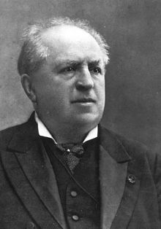
The Netherlands – later 1800s
1886: Doleantie
Second schism within the Dutch Reformed Church
Main issue: doctrinal tolerance
Flashpoint: ordination of first Free University graduate
Flashpoint: Profession of Faith in Amsterdam
Formation of Lower German Reformed Churches
Seminary: Free University in Amsterdam
Notes:
Picture is of Rev. Dr. Abraham Kuyper

Slide 8
The Netherlands – around 1900
1892: Union
Christian Reformed (A) + Low German Reformed (B)
Formation of Reformed Churches in The Netherlands (GKN)
‘Top-down’ merger
“A” and “B” churches in many villages; takes up to 40 years to merge locally.
Problem of two seminaries: Kampen and Amsterdam
Kampen: A school of the churches for the churches
Amsterdam: A university free of state and church
3 CGK refuse because of Kuyper’s influence
In the next decades many “A” churches return to Christian Reformed Church
Notes:
Problem of two seminaries relevant for North America: issues between CanRC and URC

Slide 9
Doleantie
GG
HHK
CGKN
1952
DGK
GKN
1967
GKv
Reformed Churches
in The Netherlands
2001
1892
2009
1920s
NGK
Lower German
Reformed Churches
1836
1944
NHK
1886
PKN
2004

Slide 10
Doctrinal issues
Until 1930s the CRCNA was mostly Dutch speaking, hence the church cultures of GKN and CRCNA were interwoven
(and those of the GKSA in South Africa)
Internal division over various matters
Common Grace
What can be learned about God from creation?
Pluriformity of the church / Invisible church
Churches exist with different ‘emphases’ (liturgical, doctrinal, service)
Covenant (Presumptive Regeneration)
Is an infant baptized because of presumed faith or God’s covenant
Centralized or decentralized church polity (CO article 31)
Can a general synod depose office bearers?
Notes:
Note that “presumptive regeneration” relates specifically to the reason for baptism

Slide 11
The Netherlands – mid 1900s
1905: tolerance of various positions
1926: Infallibility of Scripture (not everything was tolerated)
Geelkerken case: Was the snake of Genesis 3 real?
Formation of GKN - Hersteld Verband
1946: Rejoins the NHK (which was changing its polity)
1943: Synod enforces just one position
Doctrinal binding beyond the confessions
Discipline for all who refuse to subscribe to Kuyper’s teachings (e.g. K. Schilder)
1944: Liberation from undue doctrinal binding
Formation of Reformed Churches (liberated) (GKv)
And this all happened during World War II!

Slide 12
Geelkerken / Liberation
GG
HHK
CGKN
1952
DGK
GKN
1967
GKN - liberated
2001
2009
NGK
1892
1920s
GKN
1944
1836
GKN – Restored Federation
NHK
1886
PKN
1946
2004

Slide 13
The Netherlands – late 1900s
1967: “Outside the Federation” leads to formation of Dutch Reformed Churches (NGK)
Independent in their view of church polity
Very tolerant of diverse views (in 2004: allowed women in office)
2004: union of GKN[s] with NHK into the Protestant Church in The Netherlands
Undoes the Secession and the Doleantie
Restored Reformed Church (HHK) formed out of NHK
These may unite with the Christian Reformed Churches in The Netherlands
Continued Reformed Churches in The Netherlands formed out of GKN[s]

Slide 14
Later 1900s
GG
CGKN
1952
DGK
Restored Reformed Church
GKN
1967
GKv
2001
2009
1892
Dutch Reformed Churches
1920s
Continued GKN
GKN
1944
1836
NHK
1886
PKN
1946
2004

Slide 15
The Netherlands – GKv
2003: formation of The Reformed Churches (DGK) out of GKv
Issues: hymns, views of Sabbath-Sunday, Westminster on church
2009: formation of Reformed Churches The Netherlands (GKN) out of GKv
Issue: church practices, hermeneutics,
2017: GKv allows women in office, actively pursues reunion with NGK
2018: FRCA (Australia) end sister-church relationship with GKv
2019: CanRC (Canada) end sister-church relationship with GKv
2020: FRCSA (Sth Africa) end sister-church relationship with GKv

Slide 16
The Netherlands – GKv
2023: merger of GKv and NGK into NGK
GKv Vroomshoop goes to CGK
GKv Urk and GKv Capelle go independent
2024: merger of DGK and GKN
Early 2024: DGK cuts ties with LRC Abbotsford
Late 2024: DGK and GKN merge

Slide 17
Splits & Mergers – The Netherlands
The Reformed Churches
GG
HHK
Reformed Churches
CGKN
1952
Reformed Churches
The Netherlands
1967
GKv
2001
2009
NGK
1892
NGK
1920s
GKN
1944
1836
NHK
1886
PKN
1946
2004

Slide 18
The Netherlands – GG
1952: Visser (1947) and Van Minnen (1952) cases
Doctrinal issue within CGK: law and gospel
Ecclesiological issue within CGK: modality church
(Very complicated story as to who went where)
1953: “Steenblok” case
Steenblok: Not “offer” of the Gospel but “presentation” of the Gospel
1980: “Van den Berg” case
Van den Berg: distinguished between “coming to life” and “being born again” arguing that only after “rebirth” does “faith knowledge” exist.
2008-2009: reunification of GGN (for the most part)

Slide 19
Splits & Mergers
Old Reformed Congregations
1953
Reformed Congregations in
The Netherlands and North America
HHK
1920s
Reformed Congregations (outside the federation)
DGK
2008
Reformed Congregations
1980
GKN
1967
GKv
Christian Reformed Churches
in The Netherlands
2001
1952
2009
1892
NGK
1920s
vGKN
GKN
1944
1836
NHK
1886
PKN
1946
2004
Notes:
NRC = GG; RCNA (Gisbons Rd) = GGNNA

Slide 20
Simplified ☺ flow chart
GG
CGKN
GK
1967
NGK
1892
GKN
HHK
1836
1920s
1944
NHK
1886
PKN
2004

Slide 21
By characterization
GG & GGNNA
Similar to NRC, RCNA Free Reformed & Heritage Reformed
CGKN
Similar to Canadian Reformed & United Reformed
GK
NGK
Similar to Christian Reformed
Similar to Reformed Church in America
HHK
Similar to United Church
PKN
Notes:
Note that “similar” doesn’t mean “identical to” or “sister church of”

Slide 22
By size (data maybe out by 15 years)
GG + GGNNA – 215,000
CGKN – 75,000
GK ~3000
NGK ~ 140,000
HHK – 60,000
PKN - 1.8M (Bond: 290,000)
Notes:
Gereformeerde Bond: 290,000 in 2011; PKN: 1.8 million
HHK: 60,000 in 2018
NGK: 33,000 (2019)
GKv: 115,000 (2019)
GKN: 1300? (14 churches, 9 ministers)
DGK: 1400 (10 churches, 6? ministers)
CGKN: 75,000
GG: 108,000 (GG & GGNNA, not counting others)

Slide 23
My guess in 2020…
GG
HHK
CGKN
1952
DGK
GKN
1967
GKv
2001
2009
1892
NGK
1920s
vGKN
GKN
1944
1836
1886
NHK
PKN
1946
2004

Slide 24
Five years later…
GG
HHK
CGKN
1952
2025
DGK
2024
GK
GKN
2024
1967
GKv
NGK
2001
2023
2009
1892
NGK
1920s
vGKN
GKN
1944
1836
1886
NHK
PKN
1946
2004

Slide 25
Church Scapes
Lecture 3
North America Reformed
Wednesday October 21, 2025
Tax receipted donations:
Canada Helps – Reformed Bible College

