Slide 1

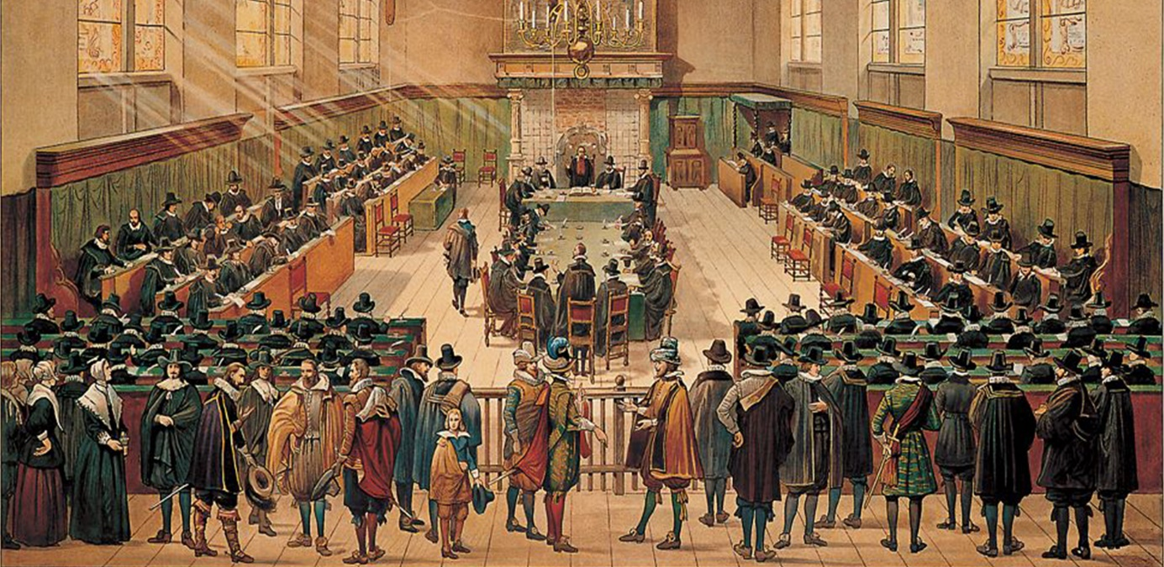
        Church Scapes
        Lecture 3
        North American Reformed
        Wednesday, October 29, 2025

Slide 2

Psalm 122:3
Pray that Jerusalem be blest:
“May peace prevail within your walls,
and safety in your citadels.
May those who love you there find rest.”
Now for the sake of friends and kin,
Jerusalem, I say again:
“May lasting peace be yours to cherish.”
And mindful that the God of grace
has in your midst his dwelling place,
I pray that you may thrive and flourish.
Read: Acts 18:1-11

Slide 3
Splits & Mergers
GG
CGKN
GKv
1892
1920s
GKN
1944
GKN
1836
NHK
NHK
1886

Slide 4
North America
Reformed Congregations
NRC, RCNA, HRC
GG
Free Reformed Churches
CGKN
Christian Reformed Churches
GKv
Canadian Reformed Churches
1892
1920s
GKN
1944
GKN
Christian Reformed Churches
1836
NHK
NHK
Reformed Churches in America
1886

Slide 5
North America - RCA
1628: First NHK in New Amsterdam (=New York)
1747: Classis America is formed
1794: independent from the NHK as Reformed Protestant Dutch Church (RPDC)
Splits:
  1822ff: Formation of True Dutch Reformed Church (TDRC)*
    Issue: Moderate vs. Strict Calvinism
    Location: New Jersey and New York
  1857: Formation of True Holland Reformed Church (THRC)
    Location: Michigan
1867: Name change: Reformed Church in America (RCA)
Notes:
*I’ve seen both True Reformed Dutch Church and True Dutch Reformed Church

Slide 6
North America - CRCNA
1847 Immigration:
  VanRaalte with Seceders to Michigan join DRC (=RCA)
  Scholte with Seceders to Iowa form independent Holland Reformed Church
1857: Formation of True Holland Reformed Church in Michigan
  Issues: hymn singing, free masonry, catechizing of children
1866: Holland Reformed Church (Pella) becomes TDRC
1890: Merger of THRC and TDRC
  Adoption of the name Christian Reformed Church

Slide 7
North America
1900
GKN
1847
HRC
TDRC
1866
1890
CAGK
CRCNA
CRCNA
1847
THRC
1794
1867
NHK
RPDC
RCA
RCA
1822
1857
Notes:
No Dutch Reformed churches yet in Canada!

Slide 8
Doctrinal issues
Until 1930s the CRCNA was mostly Dutch speaking, hence the church cultures of GKN and CRCNA were interwoven
  (and those of the GKSA/RCSA in South Africa)
Internal division over various matters
  Common Grace
    What can be learned about God from creation?
  Pluriformity of the church / Invisible church
    Churches exist with different ‘emphases’ (liturgical, doctrinal, service)
  Covenant (Presumptive Regeneration)
    Is an infant baptized because of presumed faith or God’s covenant?
  Centralized or decentralized church polity
    Can a general synod depose office bearers?
Notes:
Last slide last class

Slide 9
North America –PRC
1922: teachings of Dr. Ralph Janssen condemned
  He had quite liberal views on especially common grace
  Such views tend to promote science as a source of truth

Slide 10
North America –PRC
1922: teachings of Dr. Ralph Janssen condemned
Harm Janssen (1759)
Jan Janssen Harm Janssen (brothers)
Jan Janssen Jannes Janssen (1st cousins)
Ralph Janssen Harm Janssen (2nd cousins)
Jannes Janssen Roelf Kars Janssen
Roelfien Smith Jannes Janssen Antina Chase
Jannes Smith Roelf C. Janssen Debra Peters Jonathan Chase
CRTS Willoughby Heights Taber Mission Brazil
Notes:
Second cousin 3x removed…

Slide 11
North America –PRCA
1922: teachings of Dr. Ralph Janssen condemned
  He had quite liberal views on especially common grace
  Such views tend to promote science as a source of truth
1924: formation of the Protestant Reformed Churches in America
  Felt the CRCNA should be firmer about denying common grace
  Led by Rev. Herman Hoeksema
  Round 1950 GKv immigrants were encouraged to join the PRC
1951: a church and a group leave to become CanRC
1953: the PRCA divided, with the Orthodox Protestant Reformed Churches being formed (“De Wolff group”).

Slide 12
North America –PRCA*
1922: teachings of Dr. Ralph Janssen condemned
1924: formation of the Protestant Reformed Churches
1951: a church and a group leave to become CanRC
1953: the PRCA divided, with the Orthodox Protestant Reformed Churches being formed (“De Wolff group”).
1962: The OPRC rejoined the CRCNA
  Attempts were made to have the OPRC join the CanRC
2021: the PRCA divided, with the Reformed Protestant Churches being formed
  Issue: re the covenant of grace
    Is entirely unconditional (PRCA)
    Involves conditions of obedience in the believer’s experience (RPC)

Slide 13
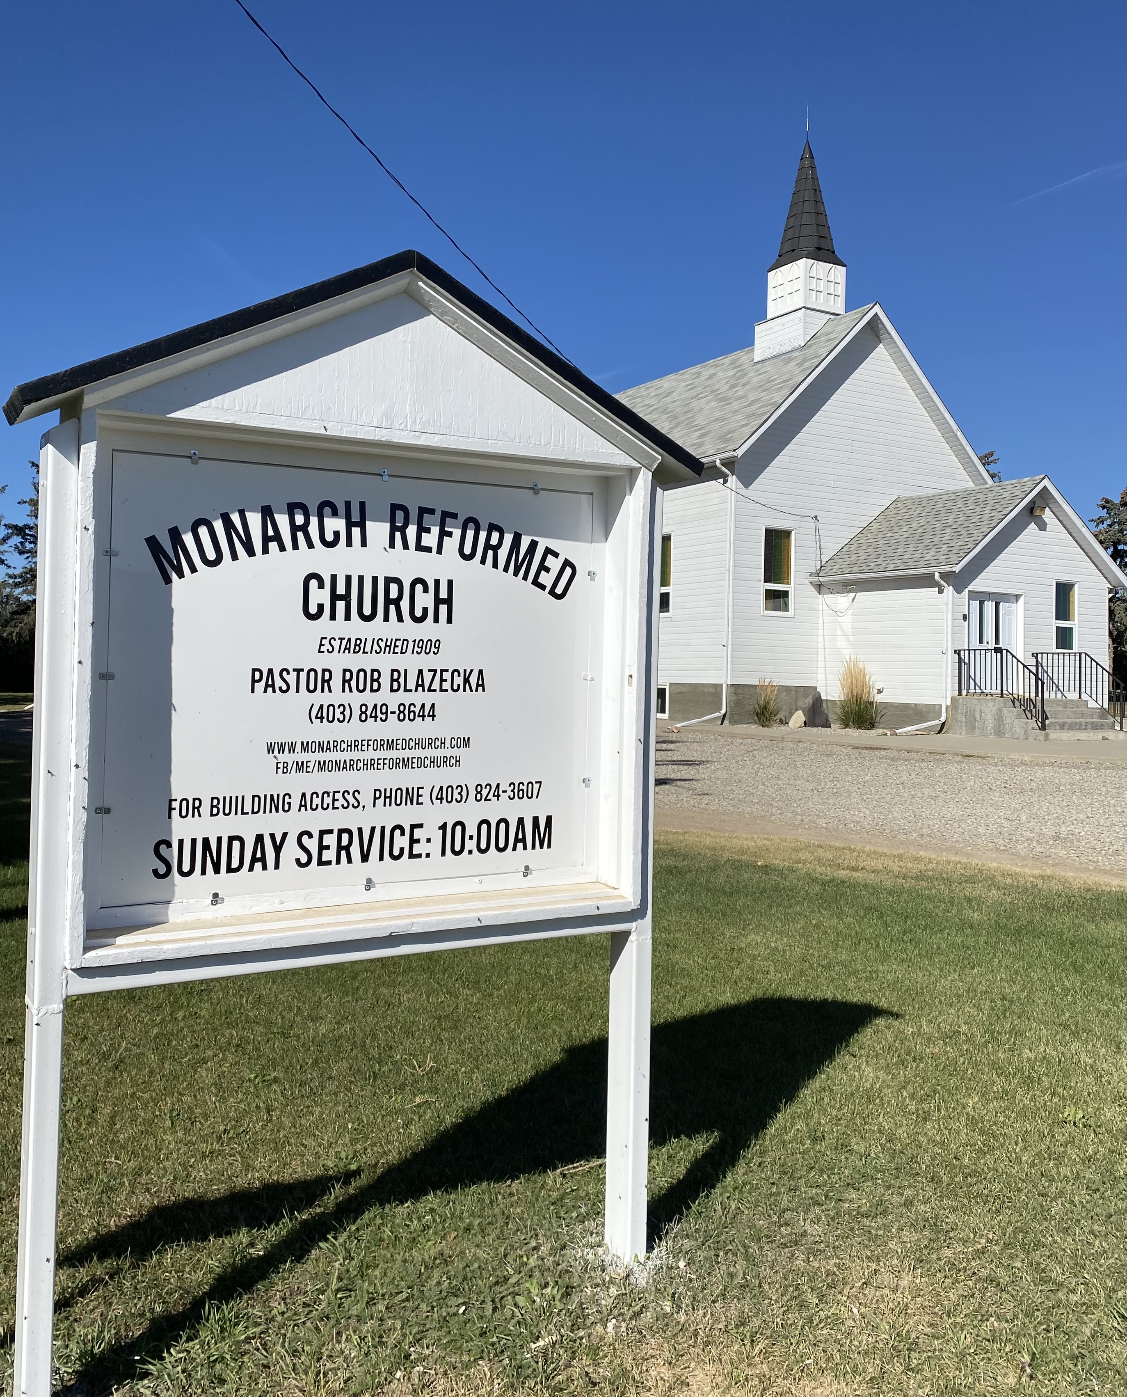
Canada
CRCNA:
  1905: First CRCNA in Nyverdall,* AB
  1910: First informal CRCNA in Edmonton
  1926: First formal CRCNA in Vancouver
1909: First RCA in Canada (Monarch, AB)
1940s: Following World War 2 there is a huge
Dutch immigration wave to North America
  Some to the USA; mostly to Canada
  Initially Reformed folks join RCA or CRCNA or start one
Notes:
There is no “

Slide 14
Canada
CRCNA: 1905 – 1910 – 1926 ???
1909: First RCA in Canada (Monarch, AB)
1940s: Following World War 2 there is a huge
Dutch immigration wave to North America
  Some to the USA; mostly to Canada
  Initially Reformed folks join RCA or CRCNA or start one
Notes:
There is no “

Slide 15
Canada
CRCNA: 1905 – 1910 – 1926 ???
1909: First RCA in Canada (Monarch, AB)
1940s: Following World War 2 there is a huge
Dutch immigration wave to North America
  Some to the USA; mostly to Canada
  Initially Reformed folks join RCA or CRCNA or start one
1948: CRCNA sides with the GKN by banning Dr. K. Schilder from CRCNA pulpits
  GKv immigrants
    form independent churches: Lethbridge, Edmonton, Georgetown,
    join PRCA: Chatham, Hamilton
Notes:
There is no “

Slide 16

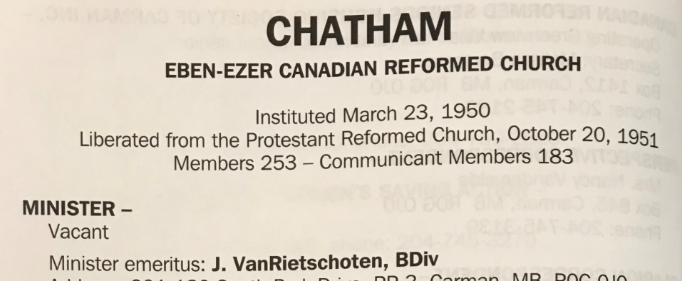
Canada
1951: PRCA adopt “Declaration of Principles”
  Issue: views on the covenant
    Doctrinal binding again!
  Liberation of Chatham, split of Hamilton; they join with New Westminster*, Lethbridge, Edmonton, Georgetown
  Canadian Reformed Churches (CanRC) are formed

Slide 17
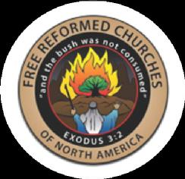
Free Reformed Churches NA
Dutch Christian Reformed
  Concern with others: Experiential preaching
  Form own churches
  Joined by two ex-CRCs
  1975: new name Free Reformed Churches of North America (FRCNA)
Reformed Congregations
remained separate

Slide 18
North America
1900
1980
GGNNA
RCNA
RCNA
GG
NRC
NRC
FRCNA
FRCNA
CGKN
1975
CanRC
CanRC
GKv
1951
PRC
1953
PRC
OPRC
GKN
CRCNA
1948
CRCNA
1924
1962
NHK
RCA
RCA

Slide 19
Reformed Congregations NA
Many sorts, main ones for North America:
  Netherlands Reformed Congregations (NRC)
  Reformed Congregations in North America (RCNA)
1993: schism in Netherlands Reformed Congregation
  Issues: Offer of the Gospel, church governance
  Formation of Heritage Reformed Congregations (HRC)
2016: FRCNA and HRC began merger talks
  These have since stalled

Slide 20

CRC / OCRC / URC
Around 1980: doctrinal tolerance
increases
  E.g. evolutionism, Biblical inerrancy
  Concerned Members :
    Formation of Mid-America Reformed Seminary
    Join CanRC (especially Surrey-Maranatha)
    Formed Orthodox Christian Reformed Churches (OCRC) in 1988
Around 1990: more doctrinal tolerance
  E.g. women in office
  Formation of Independent Christian Reformed Churches
  1995: formation of the United Reformed Churches in North America (URCNA)
Notes:
Both Abbotsford and New Westminster began as OCRCs. One of the Lynden URCNA’s is also an OCRC.

Slide 21

OCRC / URC / CREC
1988: an OCRC joins the PRC
2004: conflict within URCNA over paedocommunion
  Groups leave URCNA to join the Confederation of Reformed Evangelicals (CRE)
  2004: Renamed Confederation of Reformed Evangelical Churches
  2011: Renamed Communion of Reformed Evangelical Churches (CREC)
2008: the OCRC is absorbed by the URCNA
Notes:
Both Abbotsford and New Westminster began as OCRCs. One of the Lynden URCNA’s is also an OCRC.

Slide 22

Reformed Church in America
2021: A group of churches leave the RCA to form the Alliance of Reformed Churches
  Issue: same sex marriage
  Currently ~180 churches
  Estimate: RCA has lost 30% of its churches
  and almost 50% of its membership
In Canada: Reformation Canada Network (RCN)
  9 in BC, 1 in MB, 5 in ON

Slide 23
North America
1980
2025
RCNA
RCNA
1993
NRC
NRC
HRC
FRCNA
FRCNA
2004
PRCA
PRCA
2021
RPCA
CanRC
CanRC
2008
URCNA
URCNA
1995
OCRC
1998
CREC
1988
2004
CRCNA
1980s
CRCNA
1990s
ARC/RCN
RCA
2021
RCA

Slide 24
        Church Scapes
        Lecture 4
        Presbyterianism
        Wednesday November 26, 2025
        Tax receipted donations:
        Canada Helps – Reformed Bible College

