Slide 1

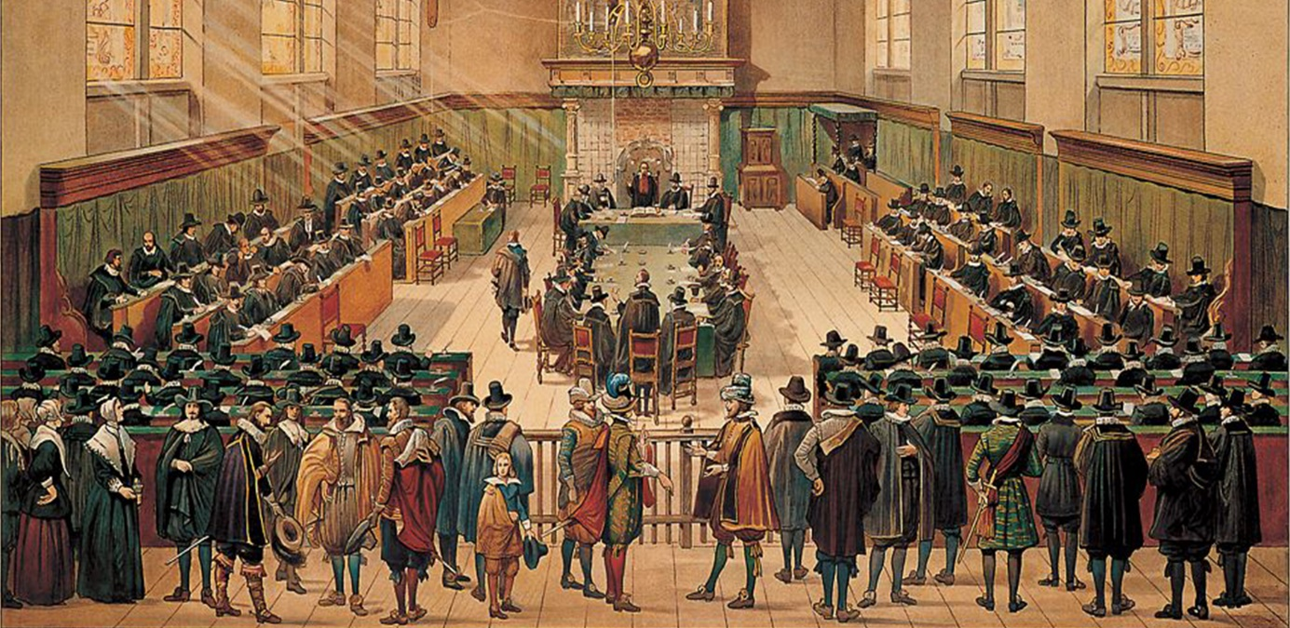
Church Scapes
Lecture 4
Continental & North American Presbyterian
Wednesday, November 26, 2025

Slide 2
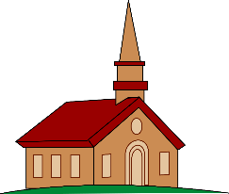
Psalm 132:4,5
4. O LORD, go to your place of rest,
you and your ark, with power blessed,
and let your faithful priests be dressed
in holiness and so proclaim
your righteousness and wondrous fame.
5. Let shouts of praise the heavens shake,
your saints their joyful anthems make;
and for your servant David’s sake,
LORD, do not turn away your face
from him, anointed by your grace.
2Chronicles 34:8-21

Slide 3
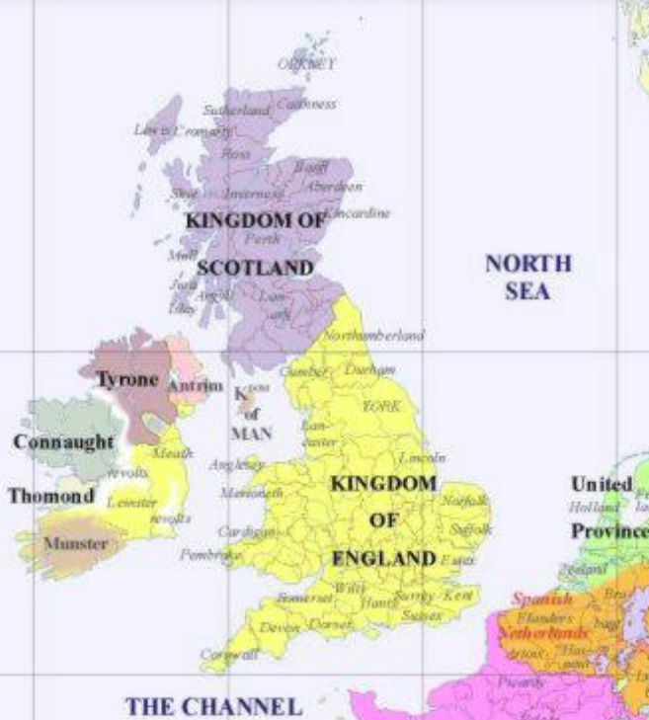
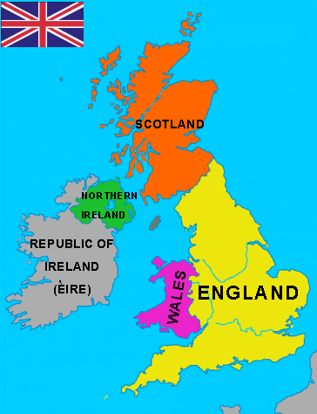
The British Islands
4 nations: England, Scotland, Wales, Ireland
1600
Today
Notes:
Left map: 1600 (from mapsof.net)

Slide 4
The British Islands
4 nations: England, Scotland, Wales, Ireland
Main churches:
Roman Catholics
Protestants
Anglicans
Presbyterians
Independents
Generally speaking Anglicans, Presbyterians, and Independents were Reformed (Calvinists)
Independents at this time were also known as Puritans
Later, Puritans are also found in Anglican and Presbyterian circles
Division mainly over church governance

Slide 5
The British Islands
Two main church governance questions
How should the local church be governed?
Church Government Technical name
Anglican By persons (bishops) Episcopalian
Presbyterian By assemblies of elders Presbyterial
Independents By church members Congregational
How should local churches relate to each other
Anglicans and Presbyterians: churches are connected
Independents: churches are autonomous
Notes:
Originally Anglicans were Reformed in doctrine and Catholic in governance
Presbyterians were Reformed in doctrine and governance
Independents were Reformed in doctrine and Anabaptist in governance

Slide 6
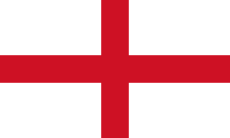
Catholic or Protestant?
1509 - Henry VIII: Protestant (Anglican)
1547 - Edward VI: Protestant (Anglican)
1553 - Mary I (aka Bloody Mary): Catholic
1558 - Elizabeth I: Protestant (Anglican)
1603 - James I / VI: Protestant (Anglican)
1625 - Charles I: Catholic / Anglican
1649-1653 – civil war
1653 - Oliver Cromwell: Protestant (Independent)
1658 - Richard Cromwell: Protestant (Independent)
1659 - Charles I: Catholic / Anglican
1660 - Charles II: Anglican
1685 - James II / VII: Catholic
Notes:
The rulers of England. James VI is king of Scotland, became king of England and hence James I.
The Cromwells are not royals. Oliver Cromwell died of ill health.

Slide 7
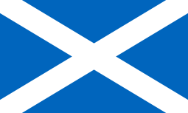
Scottish Calvinists
Covenants
1580: National Covenant (James VI)
1638: Second National Covenant (Charles I)
1643: Solemn League and Covenant
1643: Scottish Calvinists promised to help the English fight Charles I in return for making the church in England and Ireland properly Presbyterian
Thus the Solemn League and Covenant came to represent a national conversion to the Reformed faith.

Slide 8
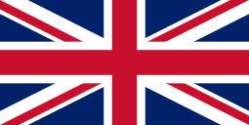
Westminster Assembly
1643-1653: a meeting is held to restructure the Church of England along Presbyterian lines
Produces:
Westminster Standards (3 documents)
Westminster Confession of Faith
Replaces the Thirty-Nine Articles (Anglican) (1553 / 1571)
Replaces the Scots Confession (1560)
Integrates the Canons of Dort into the confession
Larger Catechism (for the mature in the faith)
Shorter Catechism (for the young in the faith)
Directory for Public Worship
Similar to liturgical forms in the Book of Praise
Form of Church Government
Presbyterian model; slightly different from Dort
Notes:
39 Articles were originally 42 in 1553, were revised until in 1571 the final 39 were in place.
Canons of Dort were in The Netherlands originally an appendix to Belgic Confession article 16. They were not actually regarded as a separate confession parallel to Belgic Confession and Heidelberg Catechism until the 19th century.
Two Catechisms were written, rather than one, because the Assembly found it impossible to produce a catechism that was “both milk and meat”.

Slide 9
The British Islands after 1659
Westminster is adopted in Scotland
Westminster is rejected in England (1660)
More civil trouble
James II / VII: tries to reintroduce Catholicism
William III & Mary II: Protestants
1688: Glorious Revolution
1689: Act of Toleration
By 1690s
England & Wales: Anglican
English more Arminian, Welsh more Calvinist
Scotland: Presbyterian
Ireland: Anglican in name, Catholic in practice
Notes:
1685: Edict of Nantes revoked; 1689: Act of Toleration

Slide 10
Scottish Church Woes
Presbyterian Main Stream: Kirk of Scotland
Presbyterian Covenanters
Issue: Government should not be tolerant but profess Christ
Defended the Solemn League and Covenant
1712 / 1743: Reformed Presbyterian Church
Presbyterian Seceders
Issue: Patronage (who picks the minister)
1733 (Secession): Associate Presbyterian Church
Notes:
Only looking at what’s relevant for North America.

Slide 11
Scottish Church Woes
Free Presbyterian
Issue: State meddling in church affairs (patronage and doctrine)
1843 (Disruption): Free Church of Scotland
Issue: traditions
2001: Free Church of Scotland (Continuing)
The FCC is becoming a bit of an “international” church for very conservative Presbyterians
Both FCS and FCC are CanRC sister churches
Note that all schisms were about the relationship between church and state
Notes:
Only looking at what’s relevant for North America.

Slide 12
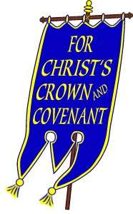
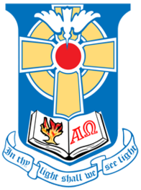
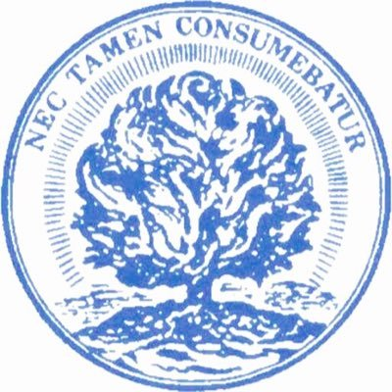
Presbyterian in Three Sorts
Reformed Presbyterians (aka Covenanters)
More theocratic and conservative
Associate Presbyterians (aka Seceders)
More experiential
Erskine brothers (Marrow Theology)
Main stream Presbyterians
More covenantal and tolerant
Includes Free Churches

Slide 13
To compare
Reformed Presbyterians (aka Covenanters)
More theocratic and conservative
Associate Presbyterians (aka Seceders)
More experiential
Main stream Presbyterians
More covenantal and tolerant
Includes Free Churches
Similar to Netherlands Reformed Congregations
Similar to Free Reformed & Heritage Reformed
Similar to Canadian Reformed & United Reformed
Notes:
Name confusions: “Reformed” can refer to Continental Calvinists OR to Theocratic Presbyterians; “Seceders” is both a name in the Scottish and in the Dutch Calvinist traditions

Slide 14
Some Scottish Schisms
1743
RPCS
ARPS
FCC
2001
FCS
1712
1733
1843
KirkS
CS
Notes:
Flow chart handed out is a bit more complex.

Slide 15
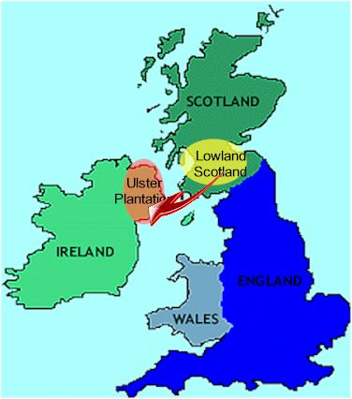
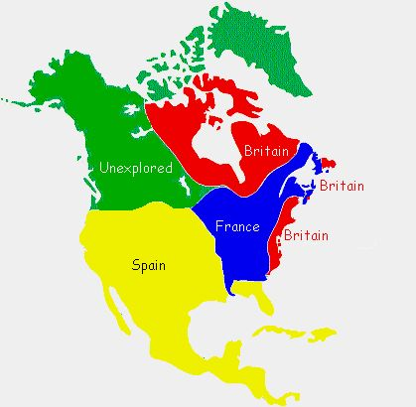
Scottish Presbyterianism
Migration of Lowland Scots to Northern Ireland in 1600s and 1700s
Causes tension between Catholics & Protestants
Many move on to Pennsylvania & Nova Scotia (North America)
Notes:
Nova Scotia = New Scotland
Caledonia is the Roman name for Scotland.

Slide 16
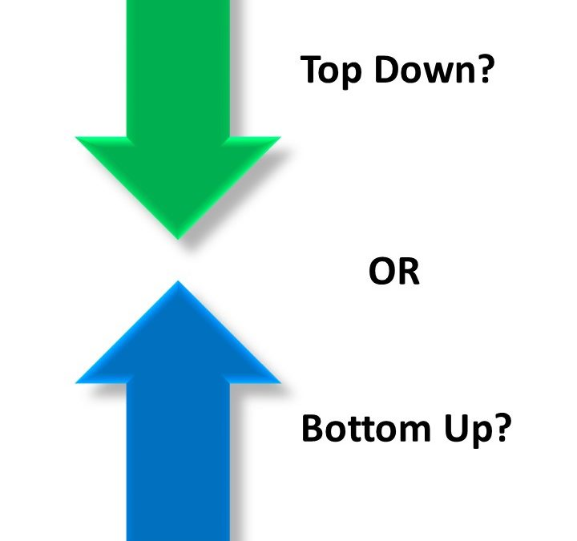
Main Stream Presbyterians
Scottish/Irish Presbyterians in Pennsylvania
English Independents in New England
Flee from England (like Pilgrim Fathers had before them)
These churches unite in 1706 to form a presbytery
Main stream Presbyterianism with an autonomous flavour
Important for church government:
Scottish Presbyterianism is top-down
American Presbyterianism is bottom-up
This is the church that eventually produced Princeton University,
Notes:
The distinction between Scottish and American Presbyterian in polity is important. In Dort circles they are often thought to be identical.
In 2022 US News ranked Princeton the highest.

Slide 17
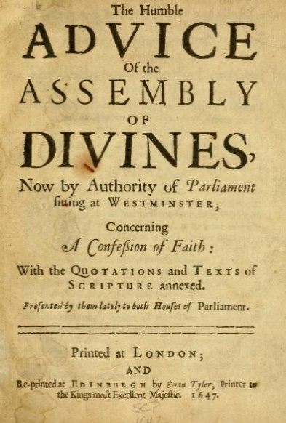
Bound to what doctrine?
1729: Discussion about being bound to the Westminster Standards.
Decision known as the Adopting Act
Problem:
in the morning it was noted that exceptions are okay
In the afternoon it was decided which exceptions are okay
Is the Adopting Act the am or pm decision?
1736: okayed exceptions only on church-state
(i.e. on sphere sovereignty!)
Notes:
Relevance of Adopting Act is 2 slides on.

Slide 18
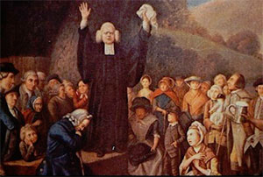
Great Awakening
The fire of repentance runs through Britain and N. America
John Wesley: Anglican & Arminian
George Whitefield: Methodist & Calvinist
Jonathan Edwards: Congregationalist & Calvinist
All emphasized need for true repentance
Presbyterian Schism in 1741:
New Side: those in favour of the revival
Tended to be English independents
Old Side: those against the revival
Tended to be Scottish/Irish Presbyterians
Reunited in 1758. But will the union hold?
Notes:
When there are mergers of groups, the subcultures tend to persist, and may cause a break in the future.

Slide 19
The Doctrine of the PCUSA
1789: first General Assembly of the PCUSA
Revision of the Westminster Standards
Especially on the point of church and state
Note: we now have two versions of the Westminster standards: Scottish and American!
Subscription in the Westminster tradition
To the system of doctrine
(Dort: to all the articles and points of doctrine)
Issue: can you disagree with a ‘point’ provided the ‘system’ remains?
Notes:
The combination of “system subscription” and confusion about what was the Adopting Act leads to a measure of confessional tolerance in Presbyterian churches, especially in the PCA.
Common exceptions are concerns with what Westminster says about the pope being the antichrist, the strict view of the Sunday as Sabbath, and consanguinity (may cousins marry).

Slide 20
Associate and Reformed
1753: formation of the Reformed Presbytery
1774: formation of the Associate Presbytery
The issue that divided them does not exist in America: there is no monarch for a covenant and there is separation of church and state
1782: Union of the two into the Associate Reformed Presbyterian Church
Some Associate Presbyterians don’t join
1793: Some Reformed Presbyterians leave ARPC

Slide 21
North America
1706
1800
Reformed Presbyterians
RPCNA
1753
1782
ARPC
1793
Associate Presbyterians
1774
APC
Old school
Presbyterians
PC
1741
1758
PCUSA
1789
Independents
New school
1706

